Slide 1


Next Generation Airline Data Exchange Simulator 1.0
VIP/Senior Project Final Presentation
Spring 2019
Team members: Isaac Reynaldo, luis herrnsdorf, gonzalo mera
Product owner: Steve luis, dr. Miguel Alonso
Instructor: dr. masoud sadjadi

Slide 2
Problem to solve
NDC as IATA’s response to direct communication between Airlines and Online Travel Agents.
NDC is an XML based protocol to follow for Airlines and OTA’s.
No Open Source Solution for simulation NDC Transactions.

Slide 3
Requirements Implemented
User can search a one way flight.
User can search a round trip flight
User can create an account.
User can add flights to their Shopping Cart.
User can search for aggregated offers from different airline, to find best deal.
User will find the wanted flights quickly.

Slide 4

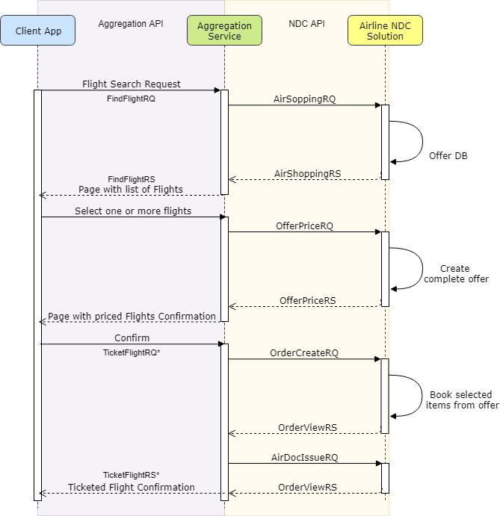



Requirements (Sequence Diagram)

Slide 5
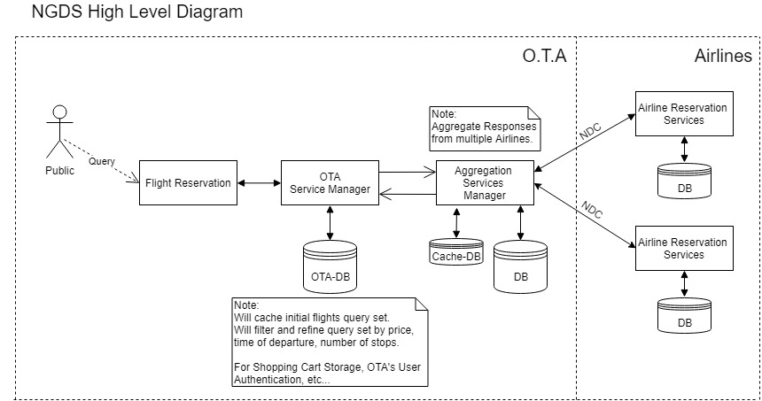
System Architecture

Slide 6
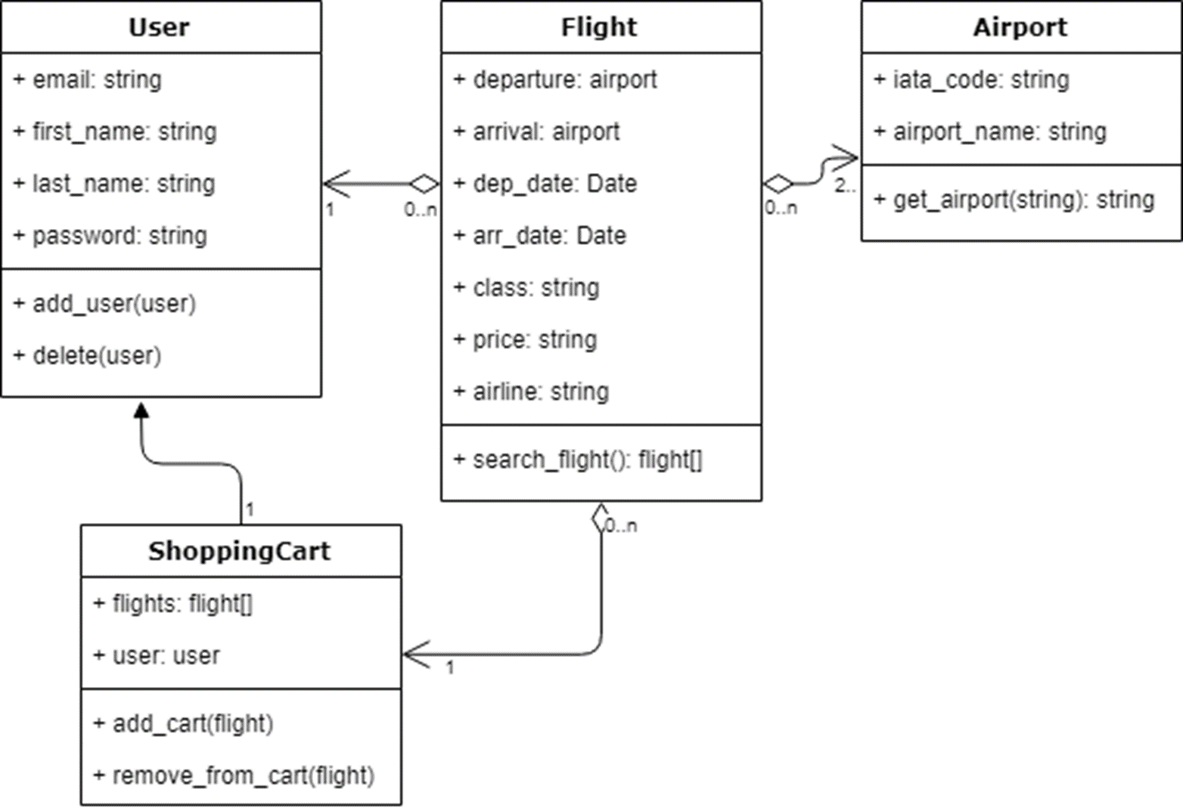
Class DIagram

Slide 7
Summary
Throughout this project we were able to demonstrate that an aggregation based service embedded to the Online Travel Agent it’s an efficient mechanism for supporting NDC transactions between Airlines and OTA’s. Bellow are the features that were implemented and the ones that should be implemented in the future.
Implemented:
One Way Flight Search.
Round Trip Flight Search.
Account Creation.
Shopping Cart.
Future Implementation:
Booking Flights.
Ticketing Flights.
Payment.

Slide 8
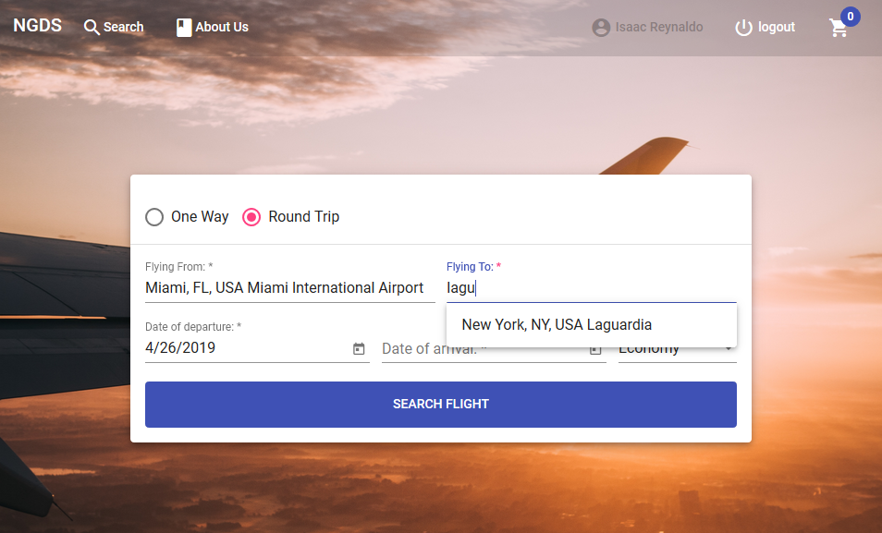
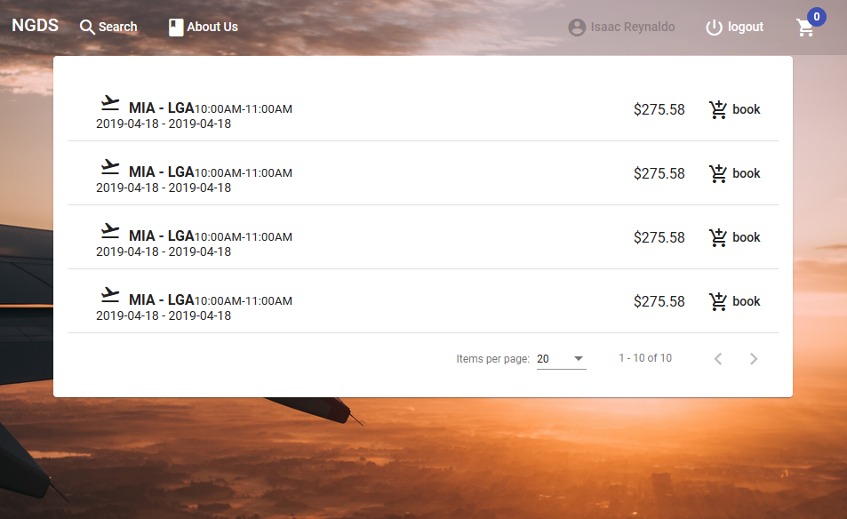
Screenshots

Slide 9
The End

